Slide 1
XG BOOST ALGORITHM
XGBoost is a powerful approach for building supervised regression models.
The validity of this statement can be inferred by knowing about its (XGBoost) objective function and base learners.
The objective function contains loss function and a regularization term.
It tells about the difference between actual values and predicted values, i.e how far the model results are from the real values.
The most common loss functions in XGBoost for regression problems is reg:linear, and that for binary classification is reg:logistics.
Ensemble learning involves training and combining individual models (known as base learners) to get a single prediction, and XGBoost is one of the ensemble learning methods.
XGBoost expects to have the base learners which are uniformly bad at the remainder so that when all the predictions are combined, bad predictions cancels out and better one sums up to form final good predictions.

Slide 2
It is same as the Gradient boosting, but has additional functionality.
DISTRIBUTED MACHINE LEARNING PROCESS
Example: We need to fill a swimming pool with full of water, using a pipe. By using a single pipe it will be taking very much time.
But while using multiple pipes it can be filled with less time.
So in ML→ Training process (High) with Highest accuracy .
Single pipe
Multiple pipe

Slide 3
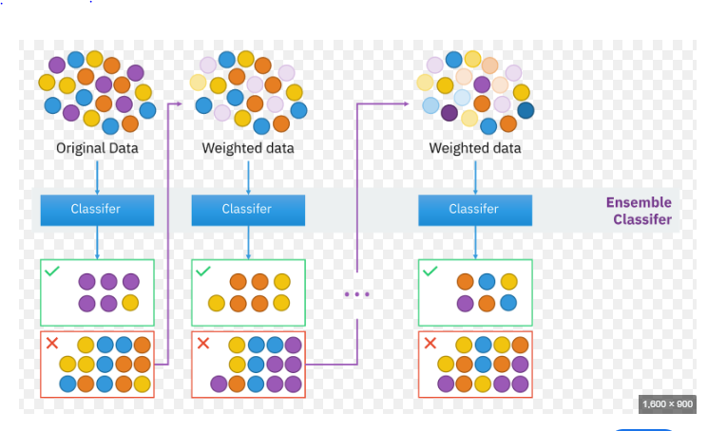

Slide 4
Advantages of XG Boost
High accuracy: XGBoost is known for its high accuracy, making it a popular choice for machine learning tasks that require high precision. It works by combining multiple decision trees to make more accurate predictions, making it effective for tasks such as image and speech recognition, natural language processing, and recommendation systems.
Speed: XGBoost is designed to be fast and efficient, even for large datasets. It is optimized for both single- and multi-core processing, making it an excellent choice for tasks that require fast predictions.
Regularization: XGBoost includes regularization techniques that help to prevent overfitting, which is a common problem in machine learning. It uses a combination of L1 and L2 regularization to reduce the complexity of the model, resulting in more robust and accurate predictions.
Flexibility: XGBoost is a flexible algorithm that can be used for a variety of machine-learning tasks, including classification, regression, and ranking. It is also compatible with a wide range of programming languages, including Python, R, and Java.

Slide 5
Disadvantages of Xg Boost
Complexity: XGBoost is a complex algorithm that requires some degree of technical expertise to implement and optimize effectively. It can be challenging to configure and tune the many hyper parameters that are involved, which can make it time-consuming to work with.
Overfitting: While XGBoost includes regularization techniques to prevent overfitting, it is still possible for the algorithm to over fit the training data. This can lead to inaccurate predictions of new data.
Memory usage: XGBoost can be memory-intensive, especially for large datasets. This can make it challenging to run on computers with limited memory, leading to slower performance.
Lack of transparency: XGBoost has often been considered a "black box" algorithm, which means that it can be difficult to interpret and understand how it arrives at its predictions. This can make it challenging to troubleshoot and fine-tune.

